Slide 1

Mini project:Automated essay feedback system
Santhosh R R
Santhosh M
Saran A
Saran S

Slide 2
Abstract:
In the field of Education Technology, personalized and timely feedback plays a vital role in improving student learning outcomes. This project introduces an Automated Essay Feedback System designed to evaluate student essays with a focus on identifying reasoning gaps, logical flaws, and argumentative inconsistencies. Leveraging advanced Natural Language Processing (NLP) techniques such as Sentence-BERT for contextual embeddings and argumentative structure analysis, the system provides real-time, context-aware feedback. A rule-based and pretrained model hybrid approach ensures insights on grammar, coherence, and content relevance. Additionally, a personalization module adapts feedback to individual learning levels and performance history. Experimental results show the system effectively delivers meaningful, human-aligned feedback, supporting critical thinking development and reducing educator workload.

Slide 3
Ideas and approach
Understanding the Problem
Breaking Down the Essay Review Process
Thinking About Automation
Brainstorming Technical Approaches

Slide 4
Things to be checked in a essay
Grammar & spelling
Logical flow & coherence
Argument strength
Relevance to the topic
Use of language/vocabulary

Slide 5
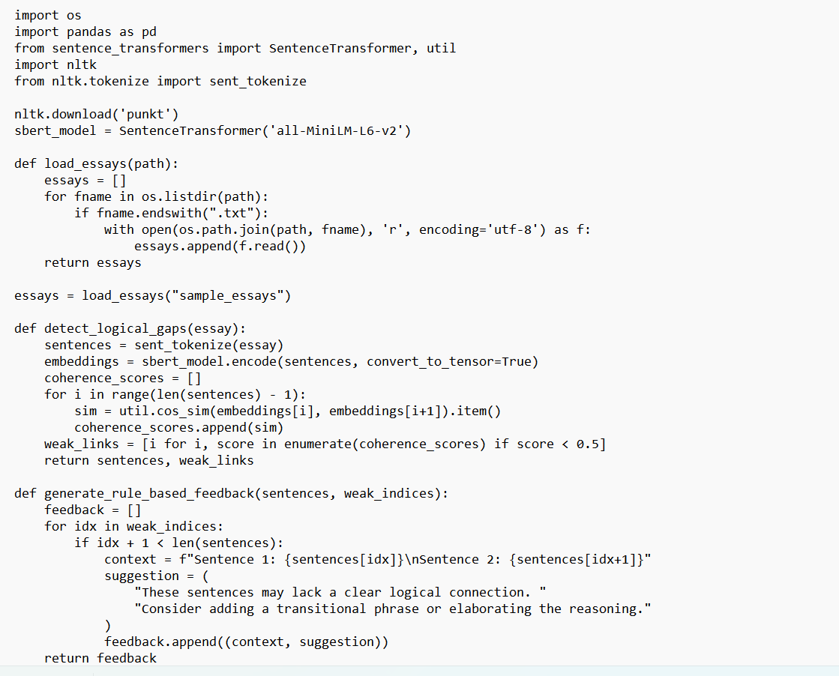
code

Slide 6
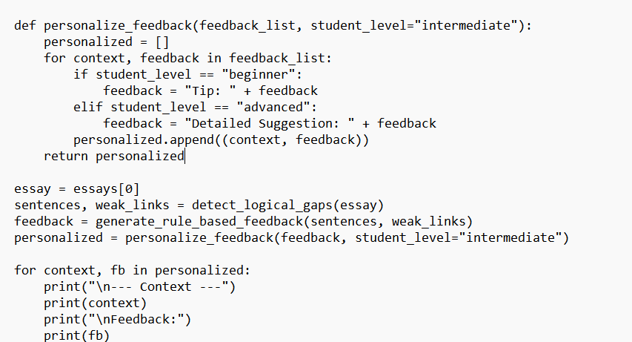
code

Slide 7
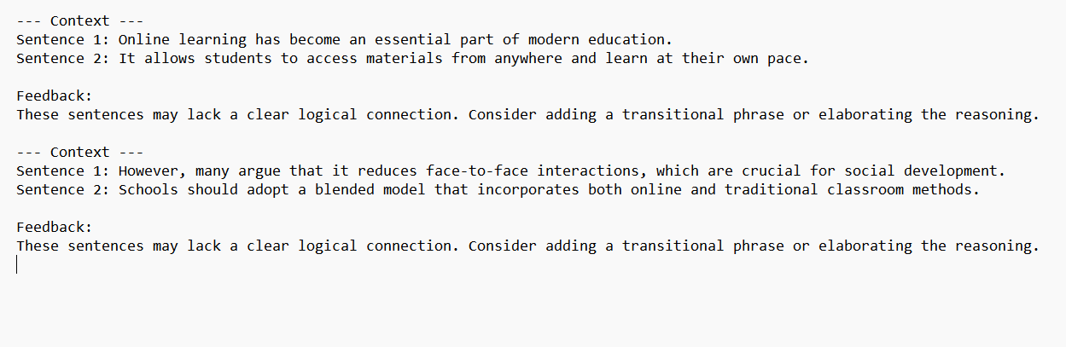
Expected ouput

Slide 8
Feature and its function:
Feature | Tool/Library | Function in the Code
Sentence Tokenization | nltk.sent_tokenize() | Splits the essay into individual sentences for analysis.
Sentence Embedding | SentenceTransformer (SBERT) | Converts each sentence into a dense vector that captures its semantic meaning.
Semantic Similarity (Coherence) | cos_sim() from sentence-transformers | Measures how similar adjacent sentence embeddings are to detect logical flow.
Weak Link Detection | Custom rule (score < 0.5) | Identifies sentence pairs with low similarity, indicating potential reasoning gaps.
Rule-based Feedback Generator | Custom logic | Provides fixed suggestions when a coherence issue is detected.
Personalization Module | Custom logic | Adjusts feedback language based on student level (beginner, intermediate, advanced).

Slide 9
Thank you

